Slide 1
Paper Review

Slide 2
LANGUAGE MODELS ARE GREEDY REASONERS: A SYSTEMATIC FORMAL ANALYSIS OF CHAIN-OF-THOUGHT
Abulhair Saparov & He He
Center for Data Science, New York University, New York, NY 10011, USA{as17582,hhe}@nyu.edu
Abulhair: A Post-Doctoral Associate at the Center for Data Science at New York University
He He: An Assistant Professor at New York University
Published as a conference paper at ICLR 2023

Slide 3
Outline
Paper - A Systematic Formal Analysis of CoT
Introduction
Dataset: PRONTOQA
Formal Analysis of Predicted Proofs
Results
Conclusion and Future Work

Slide 4
Introduction
WHY?
1. LLM has good performance with CoT(chain-of-thought) prompting
2. Existing benchmarks measure reasoning ability indirectly
By evaluating accuracy on downstream tasks such as mathematical reasoning.
Unclear how these models obtain the answers and whether they rely on simple heuristics rather than the generated chain-of-thought
→ present a new synthetic question-answering dataset called “PRONTOQA”
Analysis on INSTRUCTGPT and GPT-3
Quite capable of making correct individual deduction steps, and so are generally capable of reasoning
Have difficulty with proof planning
Notes:
Proof planning 是一种高层次的方法，它涉及到在尝试证明定理之前先构建一个大致的“计划”或“策略”。
Proof steps 是证明中的具体步骤，它们是实施 proof plan 的具体动作。
每一个 proof step 是一个逻辑上的推理单元，它将从已知的前提或已经证明的断言推导出新的结论。

Slide 5
Introduction
在CoT提示中，每個例子包括一個問題（例如，“6/3 − 1？”），回答問題所需的推理的簡短描述，稱為“Chain of Thought”（例如，“6/3是2. 2 − 1是1。”），和一個 label（例如，“1”）。在提示幾個CoT的例子時，引出的推理使得LLMs能夠比標準問答提示更高準確度地預測標籤。
現有的研究主要依賴於現實世界中的問答（QA）任務，例如數學應用問題。LLMs很可能已經通過預訓練獲得了知識，僅僅檢索答案而不是進行推理。
→ 在這項工作中，我們通過直接評估它們預測的CoT（可解釋的證明步驟），而不是預測的 標籤，系統地調查LLMs的推理能力。

Slide 6
Introduction
PRONTOQA 資料集中的每個例子都是從一個本體生成的，具有一個獨特的證明。
使用一個語法將證明轉換為語法上簡單的句子，這樣反向過程相對較容易
我們通過控制一些表徵推理任務複雜性的變量，如本體類型和所需的證明步驟數
LLMs在證明計劃方面存在困難：當模型遇到證明中存在多個有效證明步驟的點時，它們有時會選擇錯誤的步驟，這通常導致不完整的證明，隨後是不正確的答案。
模型在真實的本體上更不容易被誤導，這表明預訓練期間獲得的世界知識在LLM推理中發揮了重要作用

Slide 7
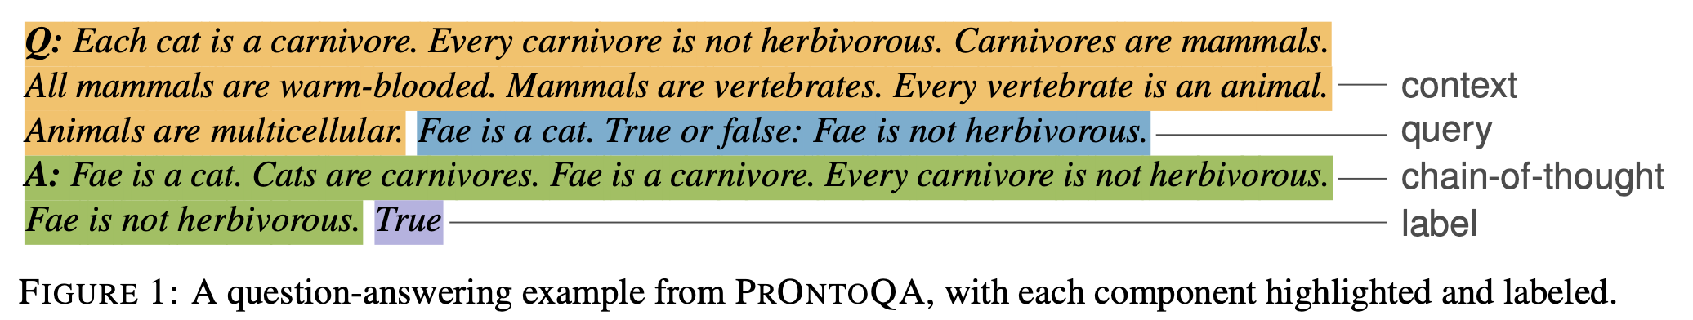
Dataset - PRONTOQA
PRONTOQA (Proof and Ontology-Generated Question-Answering)
A synthetic dataset for logical reasoning
每個問題都是從符號本體論(symbolic ontology)和證明中生成的
僅考慮可以使用重複應用 modus ponens 推理規則來回答的問題
假言推理是一個簡單的推理規則，根據前提∀x(f(x) → g(x))和f(a)，我們得出結論g(a)（例如，給定“所有貓都是食肉 動物”和“Fae是一只貓”，我們得出“Fae是一個食肉動物”；見附錄中的圖6
生成 context、query、CoT and label
Notes:
Modus Ponens(MP): 如果P，則Q；且P為真，故Q為真。
這個論證是有效的的事實不能確保在論證中的任何陳述是真的；肯定前件的有效性告訴我們結論必然是真的，如果所有前提是真的。記住在其中一個或多個前提不是真的的有效論證是不可靠的論證，而如果所有前提都是真的，則這個論證是可靠的。在多數邏輯系統中，肯定前件是有效的。但是它的應用實例可以是可靠的也可以是不可靠的。

Slide 8
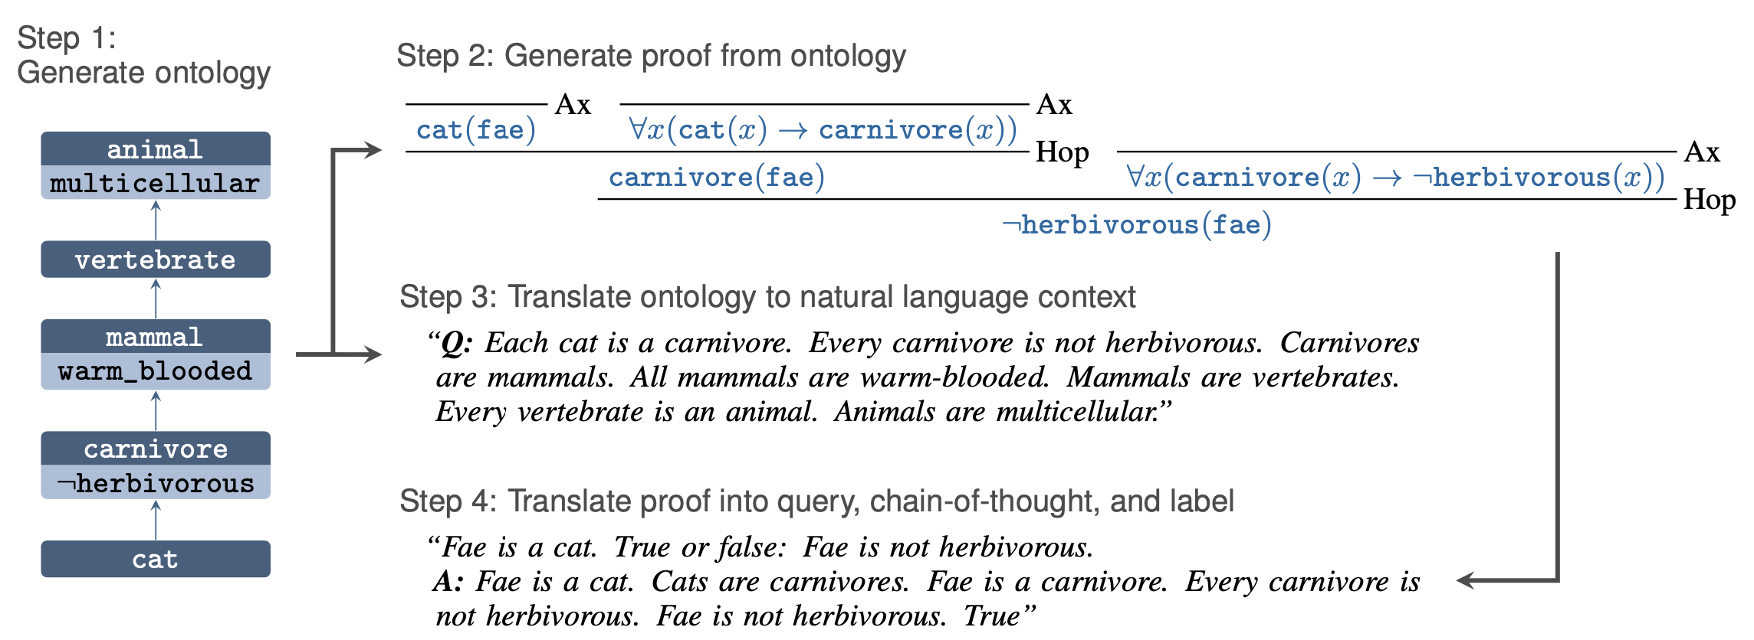
Dataset - PRONTOQA
首先從一組 concepts 生成一個 ontology
通過遍歷本體生成一個證明
將本體翻譯成 context
通過將邏輯形式映射到自然語言句子，將證明翻譯成query, CoT and label
Ontology
Concept

Slide 9
Dataset - PRONTOQA
Ontology Generation
The first step is to generate a small hierarchical ontology
The ontology is a set of concepts (e.g., mammal, cat, carnivore, etc) and subtype relations between them (e.g., ∀x(cat(x) → carnivore(x))).
The ontology also describes properties of concepts (e.g., ∀x(mammal(x) → ¬cold_blooded(x)))
To generate questions that are not overly complex, we restrict the ontologies to be linear (i.e., in the tree, every node has exactly 0 or 1 child nodes). Since ontologies are randomly generated, they vary in size from as few as 3 concepts to as many as 10.

Slide 10
Dataset - PRONTOQA
Proof Generation:
We generate proofs from the ontology by choosing a starting node uniformly at random, and generating the initial axiom indicating that an entity has a specific type (e.g., cat(fae))
Then, we walk up the tree, with each step corresponding to an application of a deduction rule (i.e., a proof step).
Each proof step consists of zero or more premises and one conclusion. We stop when we reach a node (e.g., carnivore(fae)), or a node property (e.g., ¬herbivorous(fae)), such that the number of generated proof steps matches the target number of steps.
Notes:
axiom (公理、原則)
Carnivore 肉食動物
Herbivorous 草食性的
Premises 前提

Slide 11
Dataset - PRONTOQA
Translation to Natural Language Example:
Given a generated ontology and proof → translate it into a natural language CoT example consisting of the question (context and query), CoT, and label.
We describe how each component is generated below:
We use a simple grammar to convert the formal statements of the ontology into the natural language utterances that make up the context.
Every edge in the ontology is converted into sentences such as “All cats are carnivores” or “Every cat is a carnivore.”
Properties of nodes are also converted into sentences of the form “All mammals are not cold-blooded,” etc.
The query is generated by using the same grammar to convert the initial axiom in the proof into a natural language sentence (e.g., “Fae is a cat”).

Slide 12
Dataset - PRONTOQA
Translation to Natural Language Example:
Given a generated ontology and proof → translate it into a natural language CoT example consisting of the question (context and query), CoT, and label.
We describe how each component is generated below:
We use a simple grammar to convert the formal statements of the ontology into the natural language utterances that make up the context.
Every edge in the ontology is converted into sentences such as “All cats are carnivores” or “Every cat is a carnivore.”
Properties of nodes are also converted into sentences of the form “All mammals are not cold-blooded,” etc.
The query is generated by using the same grammar to convert the initial axiom in the proof into a natural language sentence (e.g., “Fae is a cat”).
We then determine with probability 0.5 whether to ask if the conclusion of the proof is true or if its negation is false, and convert it into a natural language “true or false” query (e.g., “True or false: Fae is not herbivorous.”) and label (e.g., “True”). We convert the ordered sequence of proof steps into the CoT by translating the conclusion of each proof step into a CoT sentence.

Slide 13
Dataset - PRONTOQA
Avoiding Shortcuts:
In section A.2 in the appendix, we describe how we add distractor sentences in order to remove shortcuts that would allow the model to “guess” the answer without reasoning.
A unique feature of PRONTOQA is that it is easily programmable, with a handful of tunable knobs which we use to generate examples with varying degrees of complexity and study different aspects of reasoning in LLMs.

Slide 14
Formal Analysis of Predicted Proofs
與衡量預測答案的準確性（即“真”或“假”）不同，希望直接評估預測的 CoT，以檢查模型是否以正確的理由得出正確答案。致力於分析模型是否能夠在每個證明步驟中正確應用假設規則 (local correctness)，以及模型是否能夠提前規劃並努力證明查詢的答案 (global correctness)
Local Correctness: 計算該步驟是否來自一個或多個假設規則的應用，以及它是否需要超出 gold proofs 範圍的其他規則。
Global Correctness: 希望識別與 gold proofs 有所偏離的證明步驟。
通過根據三個維度對其進行分類，評估每個證明步驟的正確性：
Validity
Atomicity
Utility

Slide 15
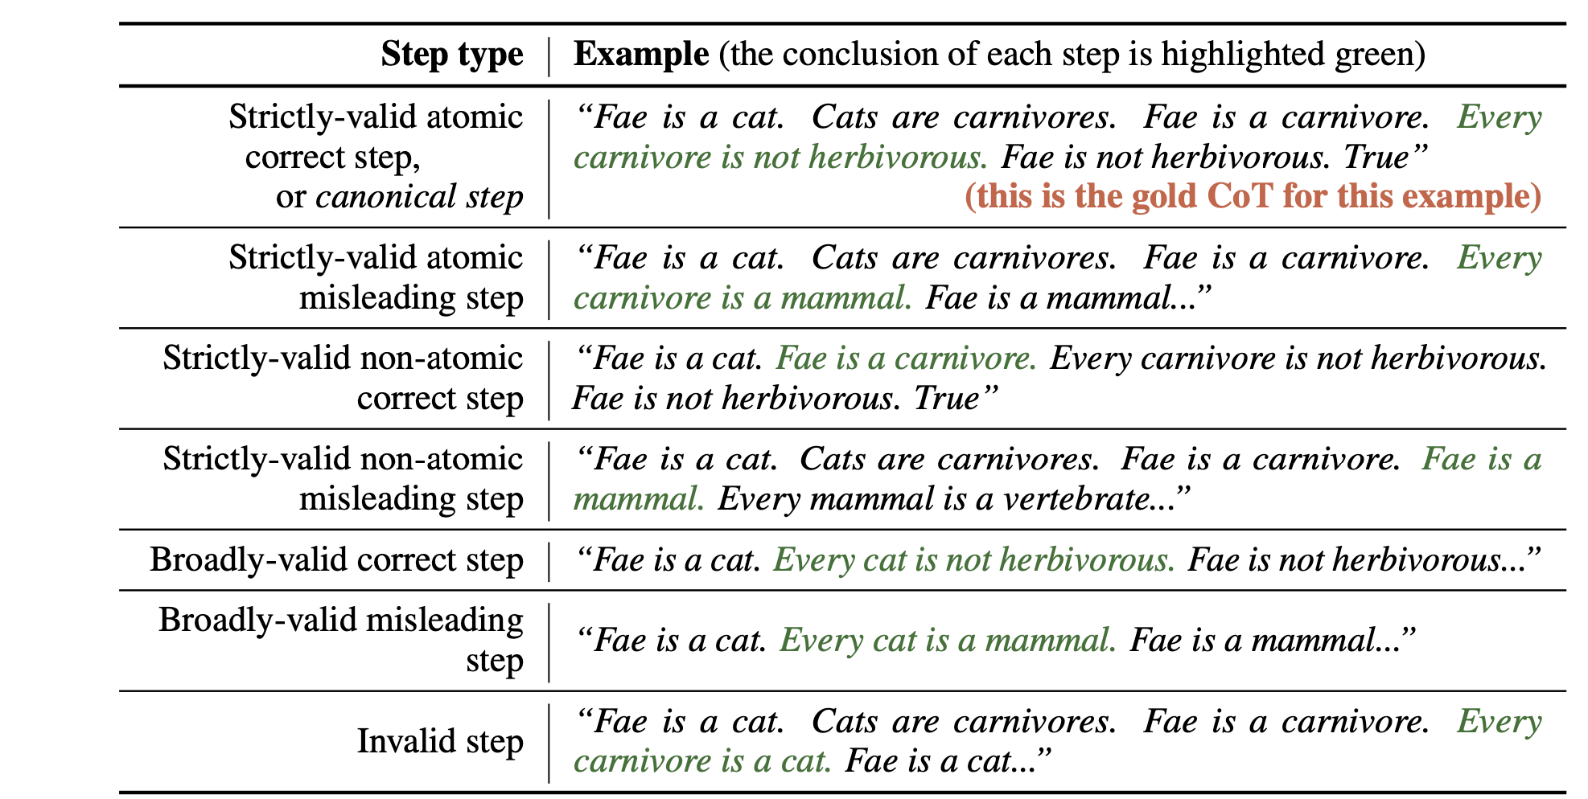
Formal Analysis of Predicted Proofs
Gold Proof
無法解析的證明步驟被標記為不正確 (incorrected)。
strictly-valid atomic correct steps = canonical steps (規範步驟)

Slide 16
Formal Analysis of Predicted Proofs
Validity:
Is the current proof step provable from previous steps?
If it is provable using only the deduction rules that appear in the gold proofs, we say the step is strictly-valid
If it is provable with a more powerful proof calculus, like natural deduction, we say the step is broadly-valid
Otherwise, we say the step is invalid
For example, given the premises, “Cats are carnivores” and “Carnivores are mammals,” the step with conclusion “Cats are mammals” is broadly-valid since an additional deduction rule is required to prove it: given ∀x(f(x) → g(x)) and ∀x(g(x) → h(x)), conclude ∀x(f(x) → h(x)).

Slide 17
Formal Analysis of Predicted Proofs
Atomicity:
Is the current proof step provable from previous steps with exactly one application of a deduction rule?
If so, we say the proof step is atomic.
Otherwise, it is non-atomic.
all broadly-valid steps are non-atomic
Utility:
If the current proof step’s premises are part of the gold proof, but its conclusion is not, then we say the proof step is misleading, otherwise, it’s correct
For example, given the premises “Fae is a carnivore,” “All carnivores are not herbivorous,” and “Carnivores are mammals,” and the goal is to prove “Fae is not herbivorous,” the step “Fae is a mammal” is misleading since although the step is strictly-valid, it does not help to prove the goal.

Slide 18
Formal Analysis of Predicted Proofs
Metrics:
基於對證明步驟的上述分類，僅當存在從前提到結論的證明步驟路徑時，才定義證明為正確 (it is possible for a correct proof to contain invalid proof steps)
我們可以要求路徑中的所有證明步驟都是規範(canonical)的 → “strict” proof accuracy
是否能夠準確測量模型的推理能力並不明顯。
更寬鬆的度量標準：
允許路徑中的證明步驟是嚴格有效的非原子正確，我們稱之為 “skip" proof accuracy
允許路徑中的證明步驟是廣義有效的，我們稱之為 “broad” proof accuracy
允許路徑中的證明步驟是嚴格或廣義有效的，我們稱之為 “valid” proof accuracy

Slide 19
Results – Experimental Setup
Generate QA examples, perform CoT prompting on the LLMs, and analyze the predicted CoTs.
Experiments on INSTRUCTGPT and the original GPT-3
Use 8-shot in-context learning
each input consists of 8 fully-labeled questions followed by a single test question with missing CoT and label
Aim to predict the CoT and label for the test question
There are some variables that we control when generating examples in PRONTOQA:
The number of hops: directly controls the difficulty of the generated example, and we experiment with 1, 3, and 5 hops.
The ordering in which the sentences are generated from the ontology: The ordering also affects the difficulty of the generated example: if the sentences are generated bottom-up, they will follow the same order as the steps in the gold proof. On the other hand, if they are generated top-down, the order is reversed, and the task may be more difficult.
The type of the ontology: We control the ontology traversal direction: We either traverse the tree top-down (i.e., preorder) or bottom-up (i.e., postorder), generating a sentence for each traversed edge/node.

Slide 20
Results – Do Correct Answer Imply Correct Reasoning?
Label accuracy may not necessarily measure whether the model is performing reasoning correctly
since the model may find ways to guess the label via heuristics.
We plot proof accuracy vs label accuracy (i.e., simply checking whether the predicted label “True” or “False” is correct).
Each point in the scatter plot corresponds to one of our 48 experiments described above. Observe that the label accuracy is poorly correlated with strict proof accuracy, and that strict proof accuracy may underestimate the model’s reasoning ability.
Rather, the most permissive accuracy metric has the highest correlation with label accuracy → label accuracy is appropriate to measure reasoning accuracy and the most permissive proof accuracy metric is most appropriate for measuring the reasoning ability of the model.

Slide 21
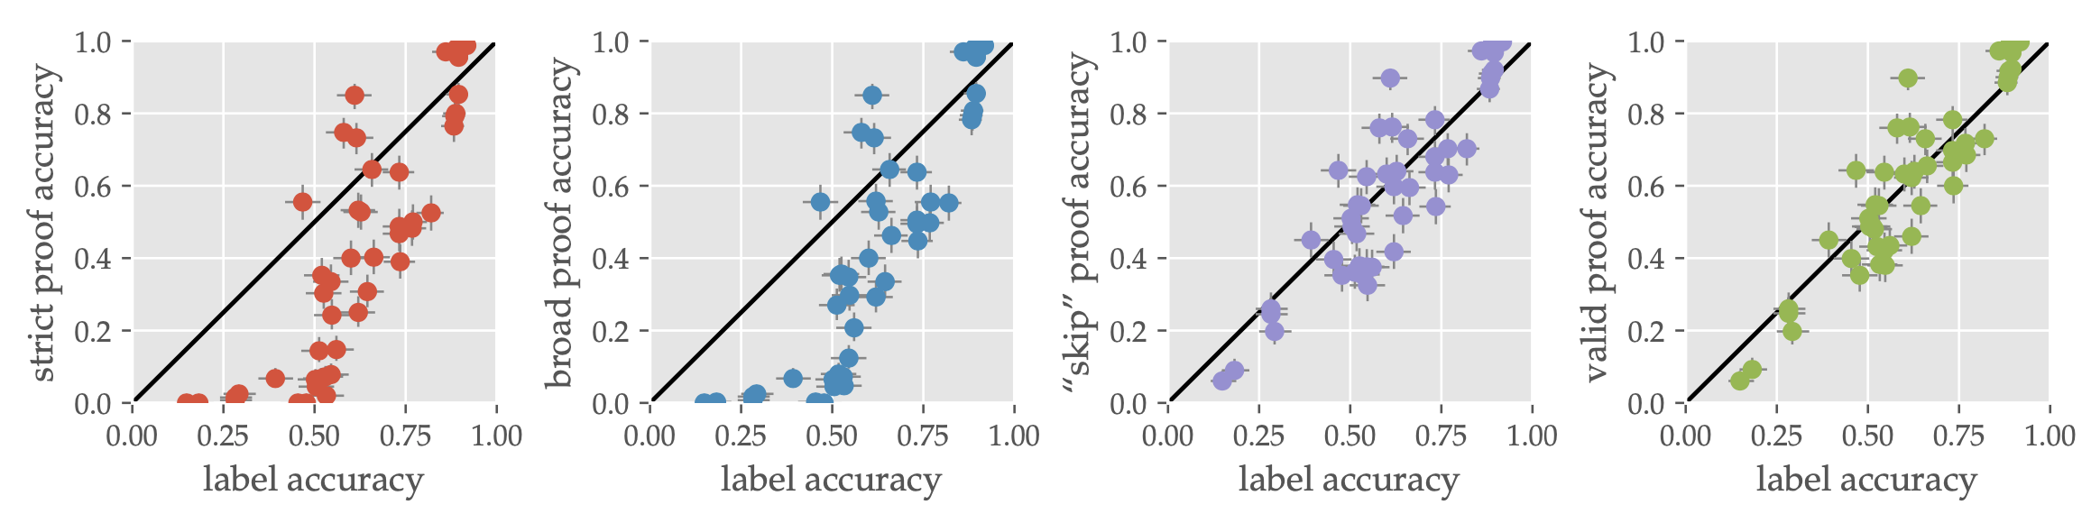
Results - Do Correct Answer Imply Correct Reasoning?
“proof accuracy” indicates the fraction of proofs (not proof steps) that are considered correct according to our metrics.
Label accuracy is not well-correlated with “strict” or “broad” proof accuracy
Label accuracy is better correlated with “skip” and “valid” proof accuracy →Suggesting that label accuracy is a good measure of reasoning ability.

Slide 22
Results - Proof Analysis Results
Only the largest model is able to reason
Investigating how reasoning ability is affected by model size → proof accuracy increases considerably when increasing the model size from 350M to 1.3B and 6.7B.
The frequency of invalid steps decreases as the model size increases, and so larger models seem to be better at making valid steps, whether or not those steps are actually useful.
Longer proofs are still challenging
Investigating the extent to which reasoning ability is affected by the number of hops in the proof
Model handles 1- and 3-hop examples quite well but struggles with 5-hop top-down examples, with accuracy falling to chance. So while it is able to perform reasoning to an extent, it is more limited as the number of hops increases.

Slide 23
Results - Proof Analysis Results
Real-world knowledge helps reasoning
Investing the effect on the “true”, “false” and “fictional” ontology
“True” has the best performance
Performance on “True” ontology doesn’t affected by the # of hop
Reasoning of the model depends on the real word data
Would be a problem for generalizability
True: ontologies use real concept names and are consistent with the real-world
False: ontologies use real concept names but the trees are generated using the random process and so it is very likely to generate a false statement, such as “All mammals are cats.”
Fictional: ontologies use fictional concept names

Slide 24
Results - Proof Analysis Results
Traversal direction affects reasoning
As the number of hops increases, the model becomes sensitive to the traversal direction of the ontology (top-down vs bottom-up)
This may be due to the fact that the order of the gold proof steps mirrors the bottom-up traversal → the task may be made more difficult for language models if the context sentences are ordered top-down (reverse)
How do LLMs reason step-by-step?
Investigating the fraction of correct and incorrect proofs that contain various types of proof steps, and whether the correctness of the proof is correlated with the presence of specific types of proof steps

Slide 25
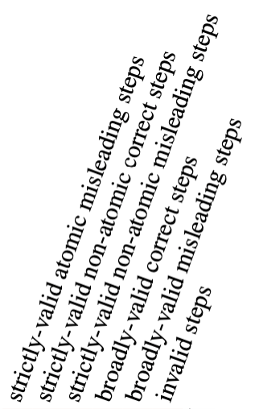
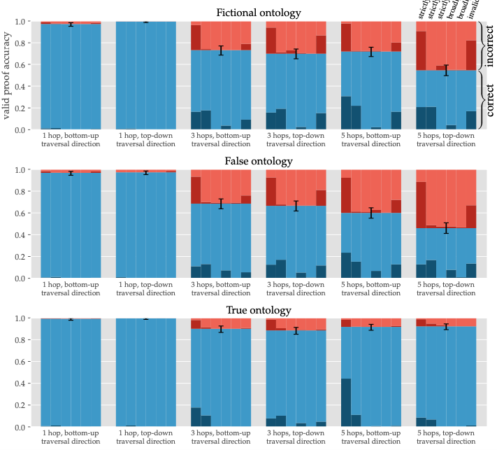
Results
This figure breaks down the bars further (in darker red and blue) to indicate the fraction of proofs that contain proof steps other than canonical steps
Most predicted proof steps were canonical (in the 5-hop experiments with fictional ontology, they constitute 93.2% of proof steps)

Slide 26
Results - Proof Analysis Results
By observing the figure in last page, we suggesting:
Most predicted proof steps are strictly-valid (in the 5-hop experiments with fictional ontology, 93.2% of proof steps are strictly-valid, 2.4% are broadly-valid, and 5.9% are invalid).
LLMs tend to skip steps by producing non-atomic steps, just as humans do when they verbalize their reasoning
Most incorrect proofs contain misleading steps and invalid steps → the source of the incorrect reasoning is either a due to a misleading step or an invalid step that causes the model to produce steps that do not belong to the gold proof.
Intriguingly, some correct proofs also contain misleading steps and invalid steps, which implies that the model is sometimes able to recover from these “mistakes” and return to the gold proof
in general, the more time the model spends outside the correct proof path, the less likely it becomes to return to the correct proof

Slide 27
Results - What Leads To a Mistake?
Investigating whether specific types of proof steps are causing INSTRUCTGPT to produce reasoning errors
To do so, we identify the first step in each incorrect proof that is not a canonical step
We observe in figure 5, among incorrect proofs, strictly-valid atomic misleading steps appear in the proof first far more often than other non-canonical step types, including invalid steps.
This indicates that for the best-performing models, the main source of reasoning error is from misleading steps, since most predicted steps are strictly-valid and atomic.
Once INSTRUCTGPT encounters a branch where one path at the fork follows the correct proof and the other paths do not, INSTRUCTGPT will select the incorrect direction with some frequency and is then not able to return to the correct path.
Smaller models are more prone to make invalid or non-atomic steps as their first non-canonical step.

Slide 28
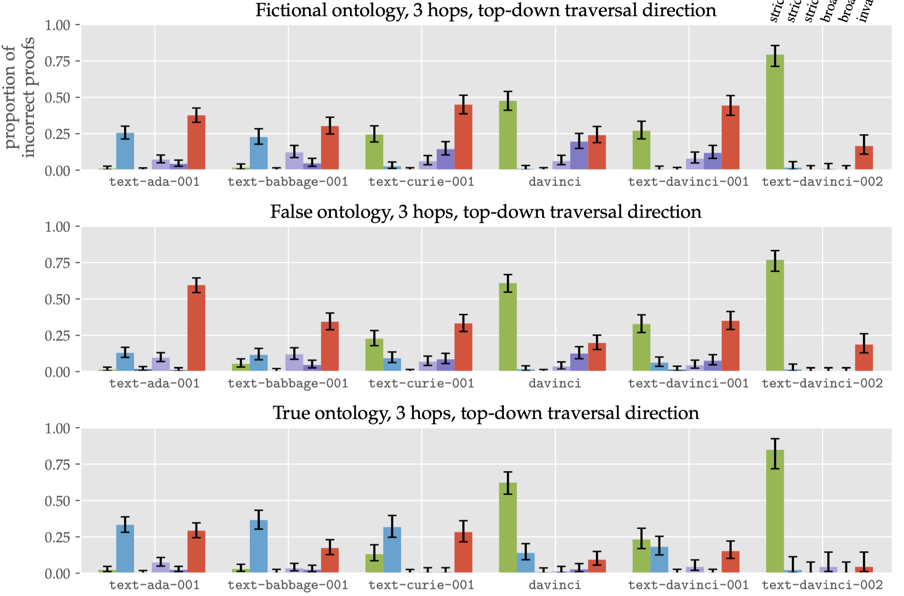
Results - What Leads To a Mistake?
FIGURE 5: Proportion of incorrect proofs versus the type of the first error (i.e., non- canonical proof step) and model size

Slide 29
Conclusion
儘管最大的模型通常能夠進行推理，但在證明規劃和在多個選擇項時選擇正確的證明步驟方面存在困難
對於更複雜的推理，例如在數學領域中，CoT提示是不足夠的，因為在這項工作中測試的推理是通用數學推理的嚴格子集
推理系統可能會受益於 more sophisticated proof planning/search strategies
PRONTOQA 可以用來比較LLM的推理與人類的推理，並探索LLM從預訓練中獲得了人類推理的哪些方面
PRONTOQA 可用於訓練新的推理系統，或者用於預訓練/微調LLMs以提高其推理能力

Slide 30
Thanks!

